Slide 1

Project Proposal: Experimentation of Machine Learning Techniques to Create a Diabetes Risk Prediction Application
Matthew Vu

Slide 2
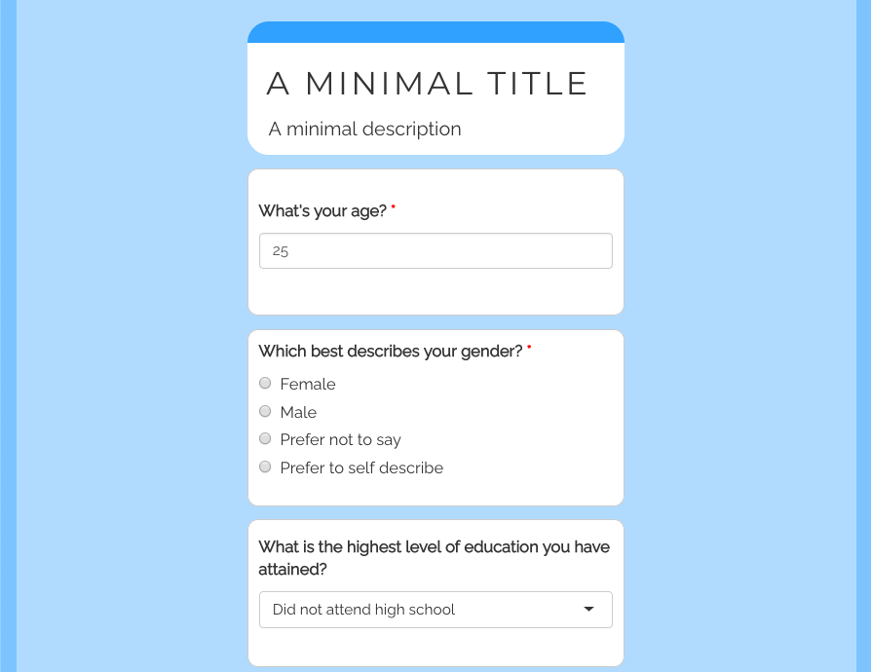
Overall Project Topic and Objective:
The topic of my capstone project is to experiment with several machine learning techniques, such as logistic regression, naïve bayes, support vector machines, k-nearest neighbor, and decisions trees, with the goal of creating a questionnaire application that can predict the risk of diabetes. Also, this capstone project will experiment with clustering the observations using Gower’s distance and Partitioning Around Medoids (PAM) to see if clustering improves model accuracy.
Idea of what the questionnaire should look like using ShinyR. Source: https://cran.r-project.org/web/packages/shinysurveys/vignettes/surveying-shinysurveys.html
Notes:
We use PAM because we have a mix of numerical and cat variables

Slide 3
Research Questions:
1. What behaviors and habits are associated with diabetes risk?
2. What machine learning algorithms out of the following is most effective at predicting diabetes risk: logistic regression, naïve bayes, support vector machines, k-nearest neighbor, and decisions trees
3. Will clustering the data using Gower’s distance and the Partition Around Medoids (PAM) clustering algorithm improve model accuracy?

Slide 4
Motivation and Importance for Research:
There still exists a high prevalence of diabetes, and many individuals do not know that they have diabetes.
According to the Center for Disease Control and Prevention’s (CDC) National Diabetes Statistics Report, over 37 million Americans have diabetes; however, about 1 in 5 of these individuals do not know that they have it (CDC, 2022).
2. There are dangerous effects of prolonged untreated diabetes.
According to the Center for Disease Control and Prevention’s (CDC) National Diabetes Statistics Report, prolonged high blood sugar levels can lead to cardiovascular disease and kidney damage (CDC, 2022).
3. Early intervention for individuals at risk of diabetes can help reduce the chances of becoming diabetic
According to a study conducted by the Diabetes Prevention Program Research Group, subjects who were administered into lifestyle early intervention programs to address their risk of diabetes contracted diabetes 58 percent less than subjects who did not participate in these programs (Diabetes Prevention Program Research Group, 2002).
4. Living with diabetes comes with financial burden
According to an academic article published in the Diabetes Care journal, “People diagnosed with diabetes, on average, have medical expenditures about 2.3 times higher than what expenditures would be in the absence of diabetes” (Petersen, 2018)
Notes:
The motivation and importance for the research and creation of this questionnaire application to help people take action stems from the fact that the early detection, prediction, intervention, and risk assessment of diabetes remains a relevant topic. In particular, there exist several reasons for continued research in this area. First, there still exist a high prevalence of diabetes and many individuals do not know that they have it. According to the Center for Disease Control and Prevention’s (CDC) National Diabetes Statistics Report, which indicates that over 37 million Americans have diabetes have diabetes; however, about 1 in 5 of these individuals do not know that they have it. So, creating an app will be beneficial because it will provide another cost-effiective resource the help advise them to take action.
In particular, the last part is of great concern because the CDC would add that prolonged high blood sugar levels can lead to cardiovascular disease and kidney damage (CDC, 2022). SO the early detection, intervention, and taking action is of great importance to prevent other unwelcomed illnesses.
Third, . Early intervention for individuals at risk of diabetes can help reduce the chances of becoming diabetic. For instance, a study conducted by the Diabetes Prevention Program Research Group discovered that subjects who were administered into lifestyle early intervention programs to address their risk of diabetes contracted diabetes 58 percent less than subjects who did not participate in these programs (Diabetes Prevention Program Research Group, 2002).
Fourth, living with diabetes comes with financial burden. In fact, “people diagnosed diabetes, on average, have medical expenditures about 2.3 times higher than what expenditures would be in the absence of diabetes” (Petersen, 2018).
With that said, creating my digital questionnaire application will give individuals yet another conveninent resource to easily be notified if they are at-risk of diabetes. This will allow them to take appropriate action, such as lifestyle changes or get a full diabetes screening.

Slide 5
Further Motivation and Literature Review:
Creating my digital questionnaire application will give individuals yet another resource to easily be notified if they are at-risk of diabetes. This will allow them to take appropriate action, such as lifestyle changes or get a full diabetes screening.
However, in addition to wanting to create an application to help individuals take appropriate action, I would also like to fill gaps in past research
Notes:
In addition to wanting to create an application to help individuals take appropriate action, I would also like to fill gaps in past research.

Slide 6
Academic Literature Review: Source 1
Title: “Likelihood Prediction of Diabetes at Early State Using Data Mining Techniques”
Summary: The book chapter describes the methodology of experimenting with data mining techniques, such as Naïve Bayes, Logistic Regression, and Random Forest, to understand if behavioral risk factors can be used to predict diabetes. They used a dataset containing diabetes behavioral risk factors, such as experiencing polyuria (excess urination), polydipsia (excessive thirst), episode of sudden weight loss, and muscle weakness. They discovered with this dataset that Random Forest performed the best. Also, they proposed the creation of a user-friendly application to assess if a person is at risk of diabetes. Although the application was proposed, it was never created.
Ways I can see improvement in research: The data could consist of other predictors that fall more in line with a person’s habits, such as diet, sleep, smoking, etc. They could have checked for multicollinearity and performed more EDA (all columns present in the dataset were used). They could have removed extraneous collinear predictors. They could have included experimentation with supper vector machines (SVM) and k-nearest neighbors (KNN) could have been conducted. They could have experimented with clustering the data to improve model accuracy. The application to assess diabetes risk could have been created.
Citation: Islam, M.M., Ferdousi, R., Rahman, S., & Bushra, H. Y. (2019). Likelihood Prediction of Diabetes at Early Stage Using Data Mining Techniques. In Computer Vision and Machine Intelligence in Medical Image Analysis (pp. 113–125). Springer Singapore. https://doi.org/10.1007/978-981-13-8798-2_12

Slide 7
Academic Literature Review: Source 2
Title: "Building Risk Prediction Models for Type 2 Diabetes Using Machine Learning Techniques“
Summary: The academic article describes using multiple machine learning algorithms, such as support vector machine, decision tree, logistic regression, random forest, neural network, and Gaussian Naive Bayes classifiers, to predict the risk of type 2 diabetes. They used a dataset that consisted of predictors describing behavioral and habitual risk factors associated with diabetes, such as difficulty seeing, depression, exercise, smoking, vaccines (flu), and history of heart disease. The dataset was sourced from the CDC’s 2014 Behavioral Risk Factor Surveillance System (BRFSS), which is the system responsible for conducting health-related telephone surveys asking about risky behaviors, chronic diseases, and the use of preventative services. They discovered that neural networks performed the best with highest the AUC.
Ways I can see improvement: The research could experiment with k-nearest neighbors (KNN). Also, they could experiment and analyze predictors describing diet, high blood pressure, high cholesterol, and difficulty walking. They could have checked for multicollinearity and performed more EDA. They could have removed extraneous collinear predictors. They could have experimented with clustering the data to improve model accuracy. Furthermore, an application that can deploy their research was not proposed or created.
Citation: Xie, Z., Nikolayeva, O., Luo, J., & Li, D. (2019). Building Risk Prediction Models for Type 2 Diabetes Using Machine Learning Techniques. Preventing Chronic Disease, 16. https://doi.org/10.5888/pcd16.190109
Notes:
Zidian Xie

Slide 8
Why Researching These Questions are Important to Me:
Add to the conversation and contribute to the use of data science concepts within the medical field
Use the concepts I learned through my previous courses to make a useful resource that can help individuals make data-driven decisions on the actions they need to take (i.e. make lifestyle changes or get a full diabetes screening)
By sharing this project on GitHub, I hope to get others involved in the use of data science in medicine. (They can improve on my methods or use the project as inspiration for their own methods)

Slide 9
Things I Hope to Review and Learn: (other than answering the research questions)
Things I hope to review from previous courses:
Data cleaning
Data Preparation
Exploratory Data Analysis (i.e. univariate data exploration, multivariate data exploration, chi-square hypothesis testing, ANOVA hypothesis testing, Cramer’s V metric of association, Variance Inflation Factor (VIF) to measure multicollinearity)
Checking for multicollinearity
Supervised ML algorithms (i.e. logistic regression, naïve bayes, support vector machines, k-nearest neighbor, and decisions trees)
Things I hope to learn more about through experience:
The concept of clustering data observations to improve model accuracy
Gower’s distance and Partition Around Medoids (PAM) clustering

Slide 10
Data Part 1: Metadata
Name: Behavioral Risk Factor Surveillance System: Public Health Surveys of 400k people in 2015
Distributor: Centers for Disease Control and Prevention
Description: It comes directly from the CDC and contains 441, 456 survey responses to the CDC’s 2015 Behavioral Risk Factor Surveillance System (BRFSS) Health Survey. Also, the 330 variables are the answers to these health survey questions. Moreover, it comes in the form of a 516 MB .csv file with 441, 457 rows and 330 columns
File Type and Size: The dataset comes in the form of a 516 MB .csv file with 441, 457 rows and 330 columns.
Reason for use: The data consist of several useful behavioral and habitual risk factors and predictors associated with diabetes, such as diet, high blood pressure, high cholesterol, and difficulty walking. Also, the dataset has plenty of variables to choose from in case I need any more variables. Also, the CDC is a reliable source, and this survey is the CDC’s main method of getting public health data.
Initial Data Processing (a starting point): Selected predictor variables that are known to be associated with diabetes, such as age, difficulty walking, high blood pressure, high cholesterol, BMI, etc inspired from another dataset from another Kaggle user Alex Teboul and domain knowledge
Citation: Centers for Disease Control and Prevention (2018). Behavioral Risk Factor Surveillance System: Public Health Surveys of 400k people in 2015. [Data set]. kaggle. https://www.kaggle.com/datasets/cdc/behavioral-risk-factor-surveillance-system
Notes:
The main dataset that will be used to train, evaluate, and test the machine learning algorithms is titled “Behavioral Risk Factor Surveillance System: Public Health Surveys of 400k people 2015”. It comes directly from the CDC and contains 441, 456 survey responses to the CDC’s 2015 Behavioral Risk Factor Surveillance System (BRFSS) Health Survey. Also, the 330 variables are the answers to these survey questions. Moreover, it comes in the form of a 516 MB .csv file with 441, 457 rows and 330 columns that is found on Kaggle. I am using this dataset because it contains several useful behavioral and habitual risk factors associated with diabetes, such as diet, high blood pressure, high cholesterol, and difficulty walking. Also, I have plenty of variables to choose from in case I need any more variables. However, for an initial starting point for analysis to make the dataset more manageable, I selected predictors that are known to be associated with diabetes, such as age, difficulty walking, high blood pressure, high cholesterol, BMI, etc inspired from another dataset from Alex Teboul and domain knowledge.

Slide 11
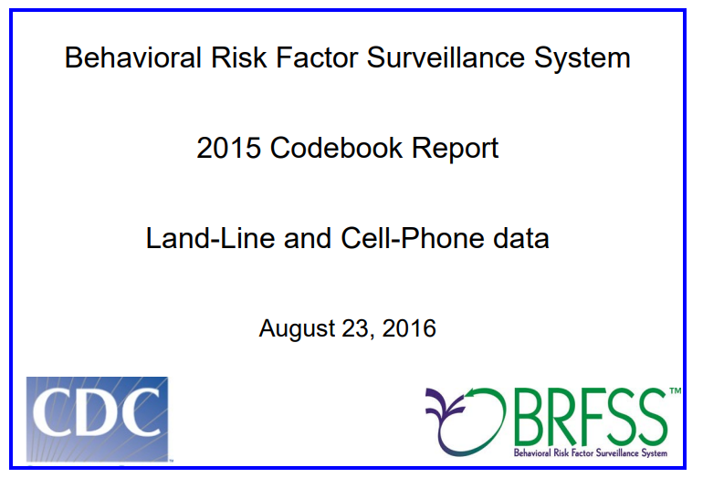
Data Part 2: Data Dictionary of the BFRSS Heath Survey Dataset
Link to Codebook: https://www.cdc.gov/brfss/annual_data/2015/pdf/codebook15_llcp.pdf

Slide 12
Data Part 3: Initial Cleaned and More Manageable Dataset
Diabetes_binary = Has diabetes?
HighBP = Has been told they have high blood pressure by a doctor, nurse, or other health professional
HighChol = Has EVER been told by a doctor, nurse or other health professional that their blood cholesterol is high
CholCheck = Has had their cholesterol checked within past five years
BMI = Body mass index
Smoker = Has smoked at least 100 cigarettes in your entire life
Stroke = Had a stroke
HeartDiseaseorAttack = Had a coronary heart disease or myocardial infarction
PhysActivity = Reported doing physical activity or exercise during the past 30 days other than their regular job
Fruits = Consumes fruit one or more times per day
Veggies = Consumes vegetables one or more times per day
HvyAlcoholConsump = Heavy drinkers (adult men having more than 14 drinks per week and adult women having more than 7 drinks per week)
AnyHealthcare = Has any kind of health care coverage, including health insurance, prepaid plans such as HMOs, or government plans such as Medicare, or Indian Health Service
NoDocbcCost = There was a time in the past 12 months when they needed to see a doctor but could not because of cost
GenHlth = General health (Excellent, very good, good, fair, Poor; 1, 2, 3, 4, 5)
MentHlth = How many days during the past 30 days was their mental health not good
PhysHlth = How many days during the past 30 days was their physical health not good
DiffWalk = Has serious difficulty walking or climbing stairs
Sex = Sex
Age = Age category (must be of 18 years or older and categories are organized in increments of 5 years)
Education = Highest grade or year of school completed (never, elementary, some high school, high schoole, some college, college; 1, 2, 3, 4, 5, 6)
Income = income level category (<10, 000, <15,000, <20,000, <25,000, <35,000, <50,000, <75,000, >75,000; 1, 2, 3, 4, 5, 6, 7, 8
Diabetes_binary | HighBP | HighChol | CholCheck | BMI | Smoker | Stroke | HeartDiseaseorAttack | PhysActivity | Fruits | Veggies | HvyAlcoholConsump | AnyHealthcare | NoDocbcCost | GenHlth | MentHlth | PhysHlth | DiffWalk | Sex | Age | Education | Income
0 | 1 | 0 | 1 | 26 | 0 | 0 | 0 | 1 | 0 | 1 | 0 | 1 | 0 | 3 | 5 | 30 | 0 | 1 | 4 | 6 | 8
0 | 1 | 1 | 1 | 26 | 1 | 1 | 0 | 0 | 1 | 0 | 0 | 1 | 0 | 3 | 0 | 0 | 0 | 1 | 12 | 6 | 8
0 | 0 | 0 | 1 | 26 | 0 | 0 | 0 | 1 | 1 | 1 | 0 | 1 | 0 | 1 | 0 | 10 | 0 | 1 | 13 | 6 | 8
0 | 1 | 1 | 1 | 28 | 1 | 0 | 0 | 1 | 1 | 1 | 0 | 1 | 0 | 3 | 0 | 3 | 0 | 1 | 11 | 6 | 8
0 | 0 | 0 | 1 | 29 | 1 | 0 | 0 | 1 | 1 | 1 | 0 | 1 | 0 | 2 | 0 | 0 | 0 | 0 | 8 | 5 | 8
Table 1: The first 5 rows of the “Behavioral Risk Factor Surveillance System: Public Health Surveys of 400k people in 2015” dataset . Data source: https://www.kaggle.com/datasets/cdc/behavioral-risk-factor-surveillance-system
Notes:
diet, high blood pressure, high cholesterol, and difficulty walking.

Slide 13
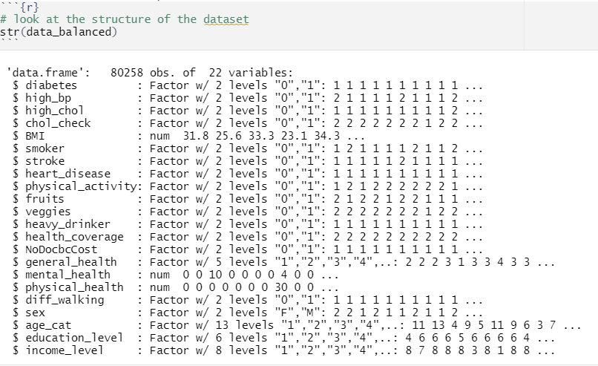
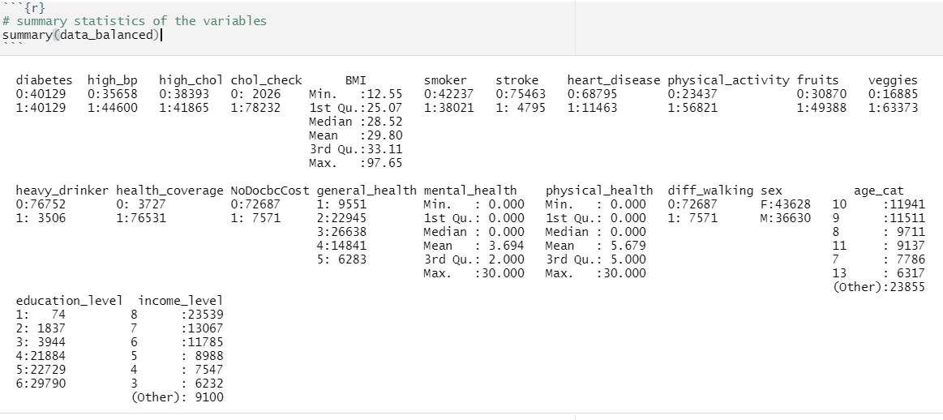
Data Part 4: Cleaned Data Structure and Summary

Slide 14
Methods of Analysis:
Exploratory Data Analysis will be conducted in a traditional manner (i.e. univariate exploration, multivariate data exploration, chi-square hypothesis testing, ANOVA hypothesis testing, Cramer’s V metric of association, Variance Inflation Factor (VIF) to measure multicollinearity)
Select Variables that are not highly associated amongst each other and are significantly associated with diabetes
The data will be split into a 50-25-25 training, validation, and test set. Note, we can do this because even the cleaned dataset still has over 200,000 observations. The training set will be used to train the algorithms; the validation set will be used assess the model’s accuracy, choose which ML algorithm is the best, and whether to cluster or not to cluster; and the test set will only be used to finally calculate the generalization error of the best method and ML algorithm
Logistic regression, naïve bayes, support vector machines, k-nearest neighbor, and decisions trees will be trained without PAM clustering and evaluated.
Logistic regression, naïve bayes, support vector machines, k-nearest neighbor, and decisions trees will be trained with PAM clustering and evaluated by using average error. (note, I use Gower’s distance and PAM clustering because I have a mixture of nominal and numerical variables)
The best combination of algorithm and clustering (or not clustering) will be used in the application
Calculate generalization error on the test set
Notes:
First, the data will be split into a 50-25-25 training, validation, and test set. The training set will be used for model training and analysis, the validation set will be used for assessing model performance and selection, and the test set will be for calculating the generalization error. Note, we can do this because we still have over 200,000 observations even when NA rows are removed. Second, logistic regression, naïve bayes, support vector machines, k-nearest neighbor, and decisions trees will be trained using no segmentation. Third, their accuracy will be assessed on the validation set. Fourth, split the training set into two groups: one group that makes less than $50,000 and another that makes more than $50,000. Fourth, repeat steps 2 and 3 but train the models on the segments and calculate the average accuracy on the validation set. Fifth, pick the model and method that performed the best on the validation set. Sixth, calculate generalization error using the test set. Seventh, create application.

Slide 15
Software and Packages:
R
RStudio
Tidyverse (for general use)
ISLR2 (for ML algorithms)
Daisy (for PAM clustering)
ShinyR (for application creation)

Slide 16
Write and Present Final Project Deliverables
1. Load Data
Data Cleaning (i.e. change variable names, recode values, remove rows with missing values)
4. Deployment
Program application
Exploratory Data Analysis (i.e. univariate exploration, multivariate exploration, check for significant predictors, check for multicollinearity)
Calculate the generalization error of the best combination of prediction algorithm and clustering (or not clustering) using the test set
2. Data Preparation
3. Modeling
Variable Selection
Select best combination of prediction algorithm and clustering (or not clustering)
Train logistic regression, naïve bayes, support vector machines, k-nearest neighbor, and decisions tree algorithms with and without clustering using the training set
Assess accuracy using the validation set
Split data into 50-25-25 training, validation, and test set

Slide 17
Progress to Date On the next few slides…

Slide 18
Cleaned Data Structure and Summary

Slide 19
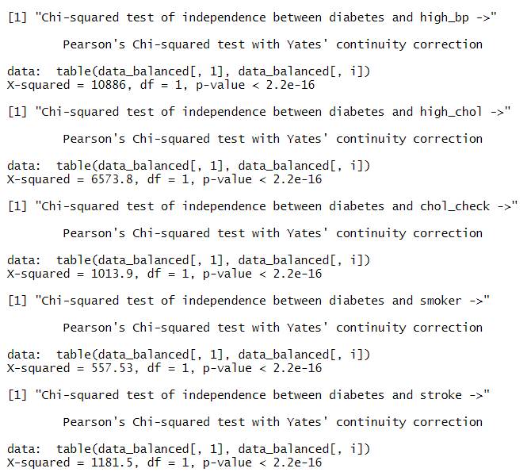
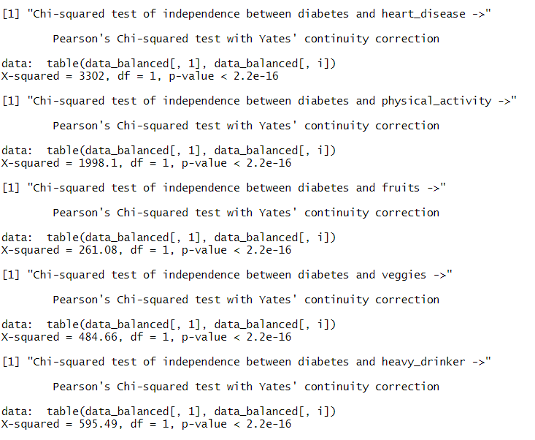
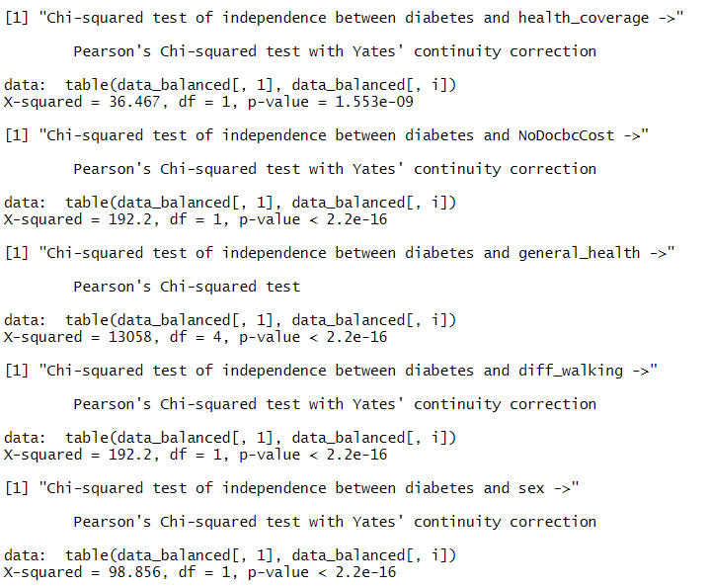
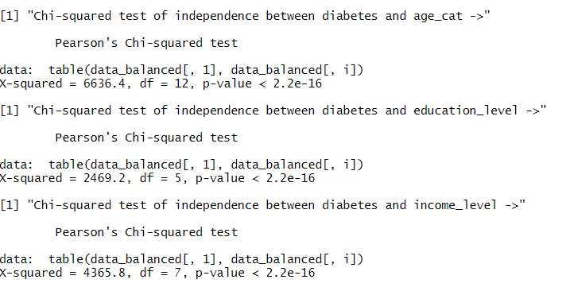
Hypothesis Testing for the Relationship between Factor Type Predictors and Diabetes

Slide 20
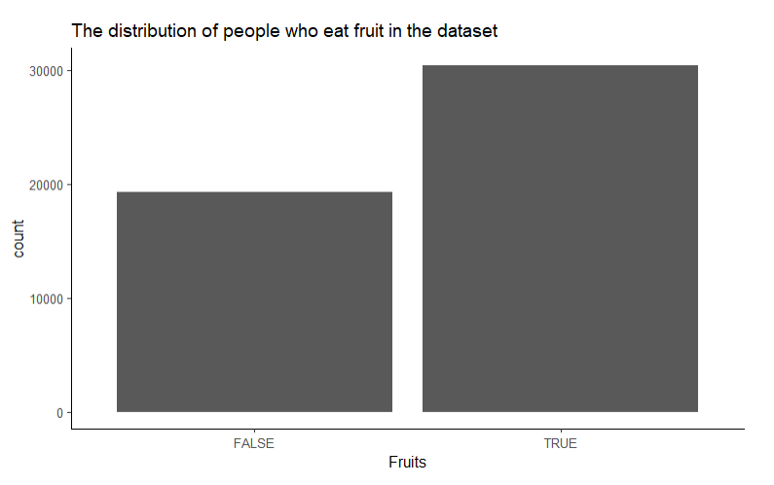
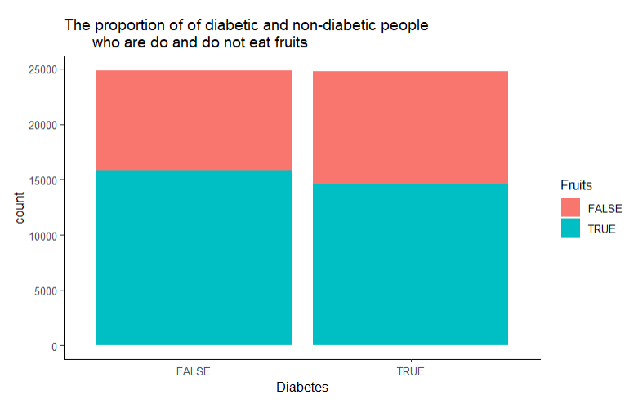
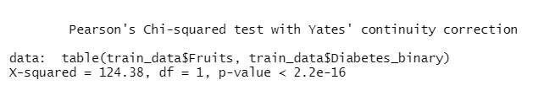
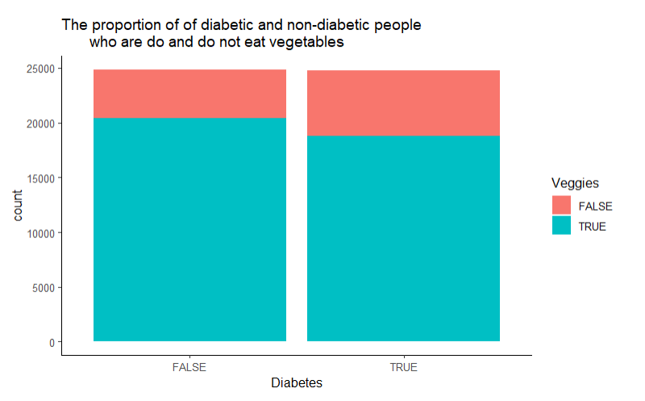
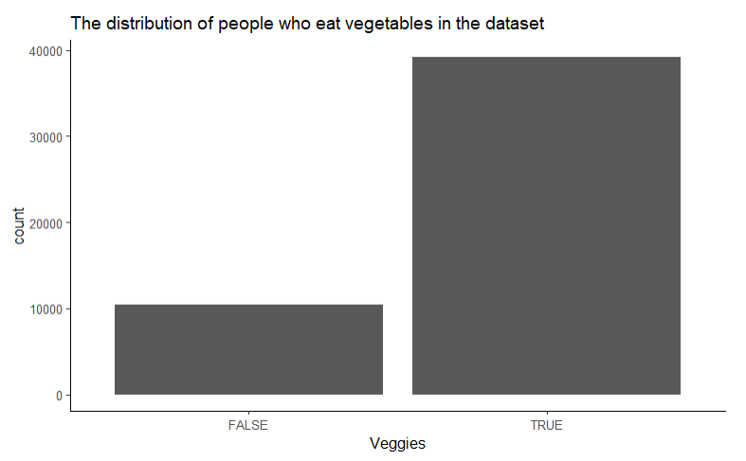
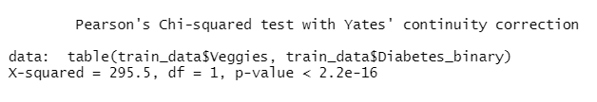
Exploratory Data Analysis Part 1: Diet

Slide 21
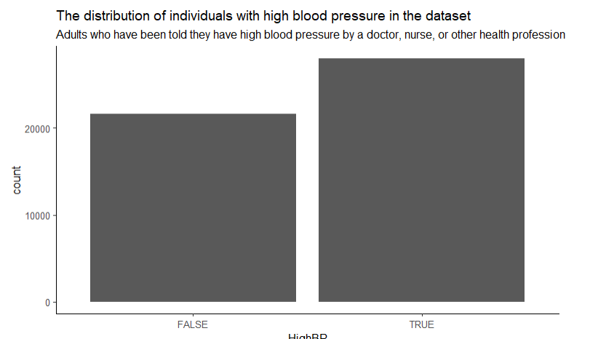
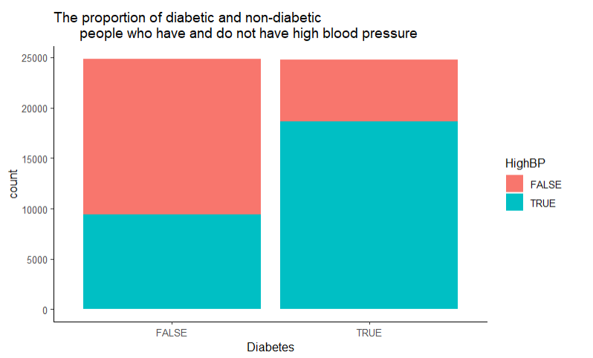

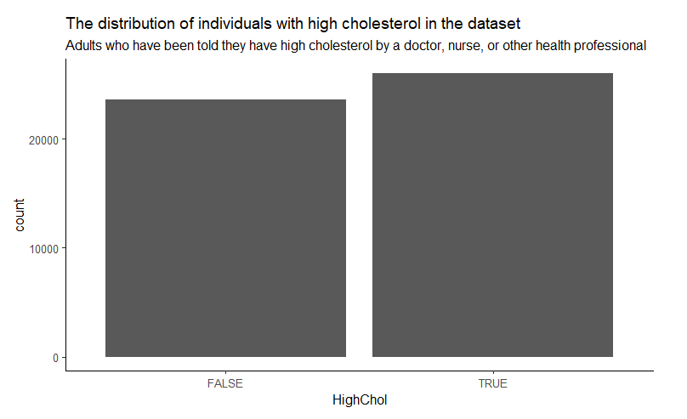
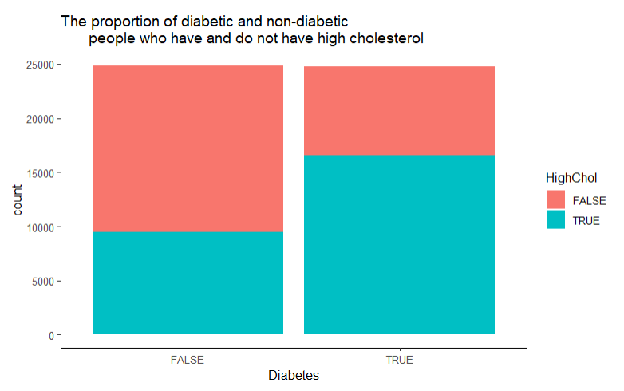
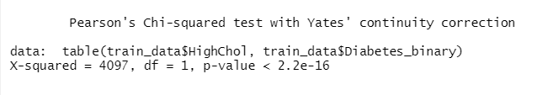
Exploratory Data Analysis Part 2: High Blood Pressure and High Cholesterol

Slide 22
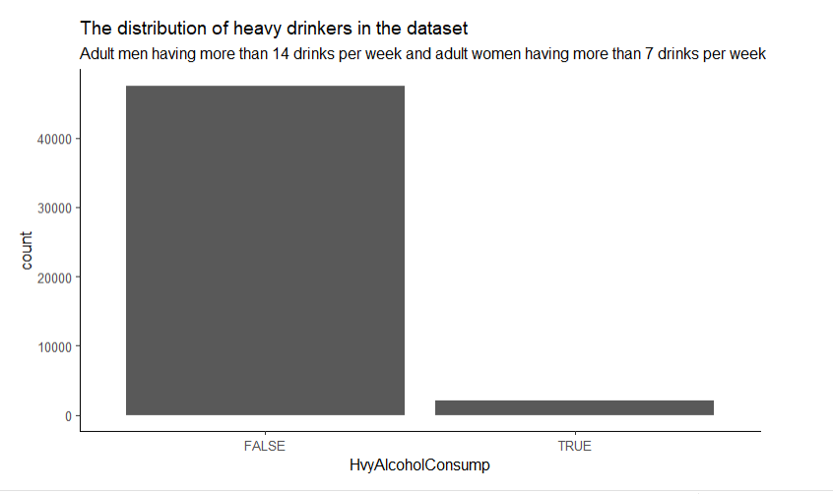
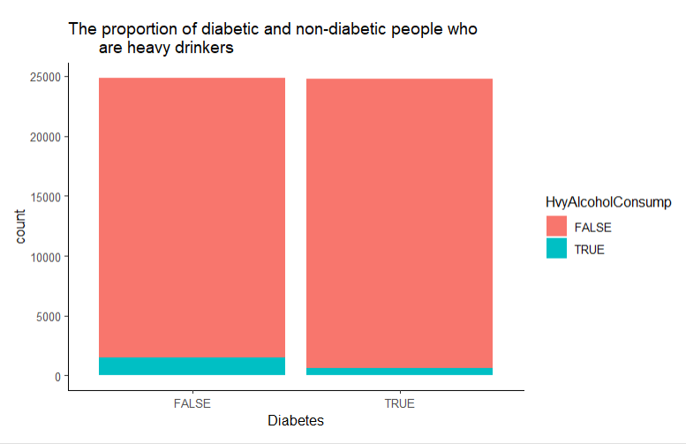
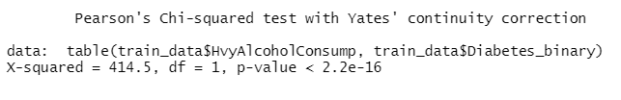
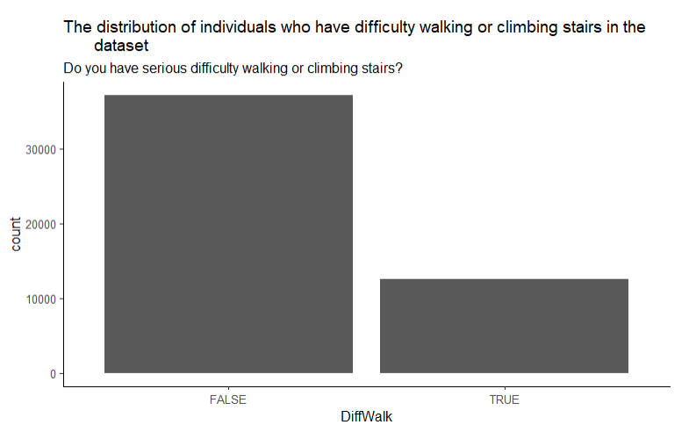
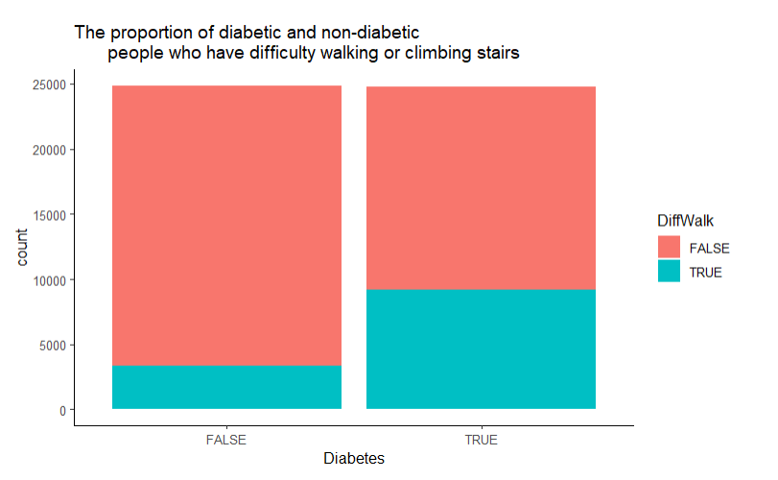
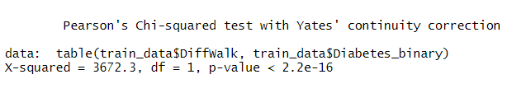
Exploratory Data Analysis Part 3: Heavy Alcohol Consumption and Difficulty Walking
Notes:
This is strange because alcohol has a lot of sugar, which can equate to diabetes. However, it makes sense that there are a greater proportion of non-diabetic people who are heavy drinkers than diabetic people because when people have diabetes, they do not want to drink because it might kill them. As a result, this variable might not be the best variable to continue on with our analysis. Also, this might be caused by the fact that so few observations are heavy drinkers. A better variable might be "have you been a heavy or binge drinker in the past".

Slide 23
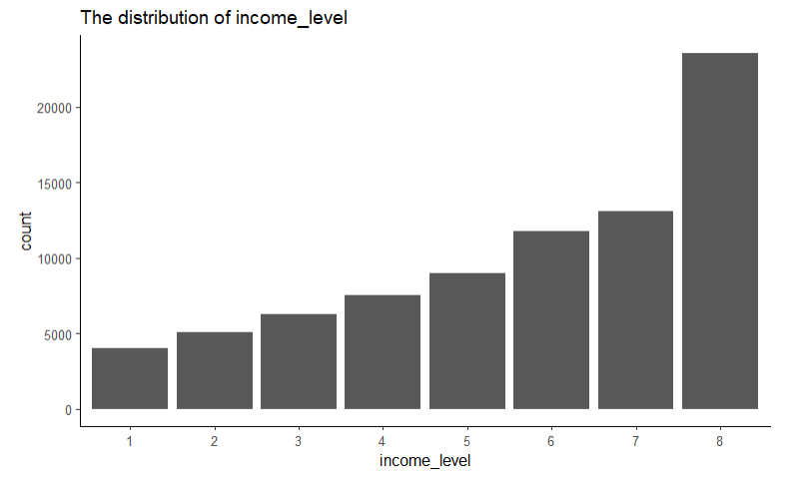
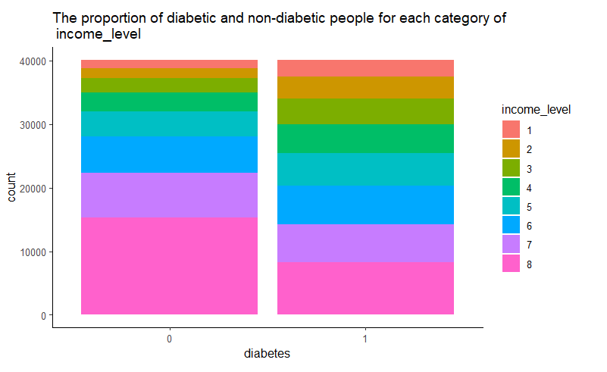
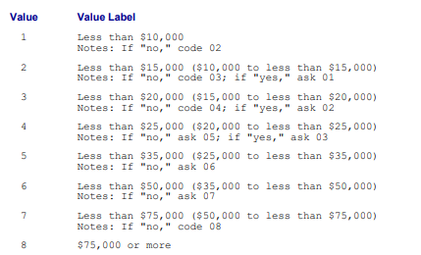
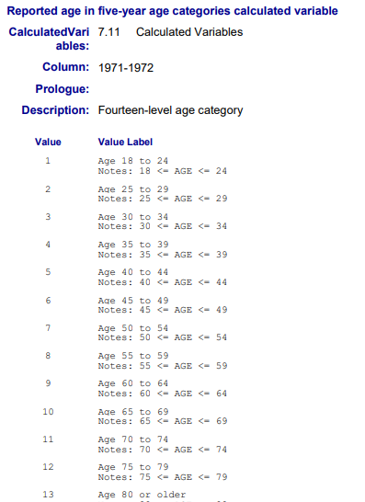
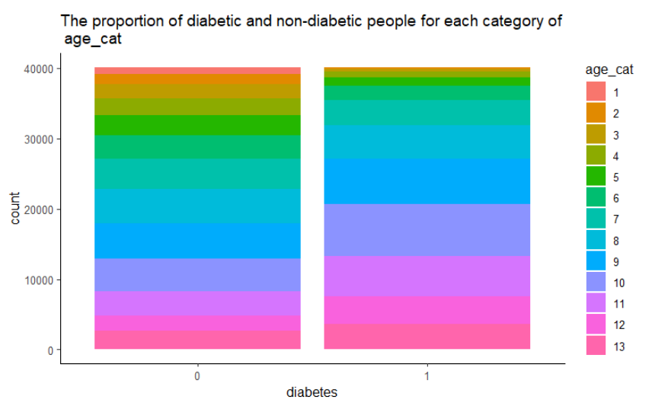
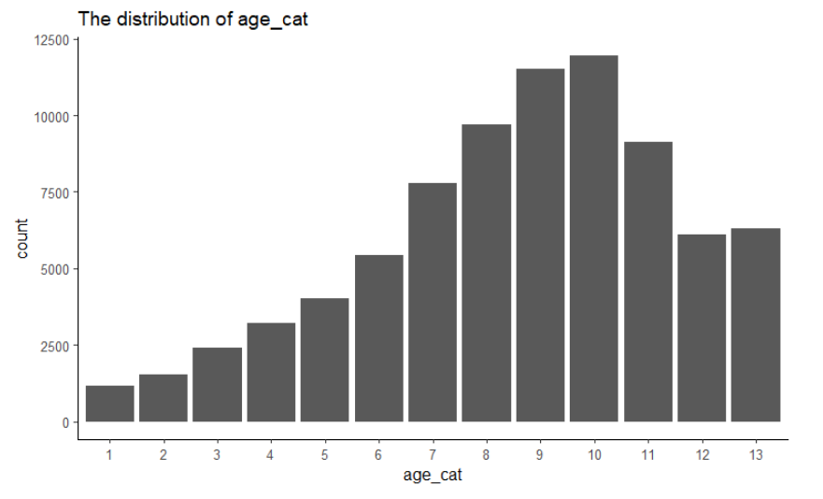
Exploratory Data Analysis Part 4: Income Level and Age Category
Notes:
This is strange because alcohol has a lot of sugar, which can equate to diabetes. However, it makes sense that there are a greater proportion of non-diabetic people who are heavy drinkers than diabetic people because when people have diabetes, they do not want to drink because it might kill them. As a result, this variable might not be the best variable to continue on with our analysis. Also, this might be caused by the fact that so few observations are heavy drinkers. A better variable might be "have you been a heavy or binge drinker in the past".

Slide 24
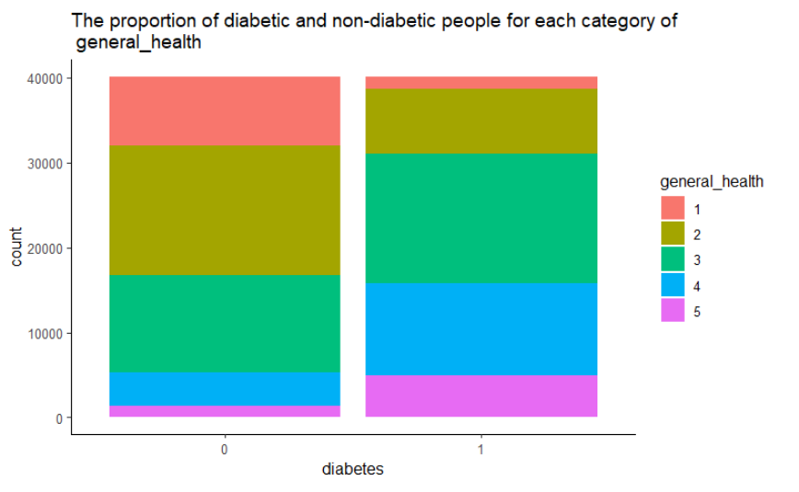
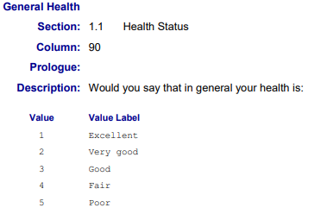
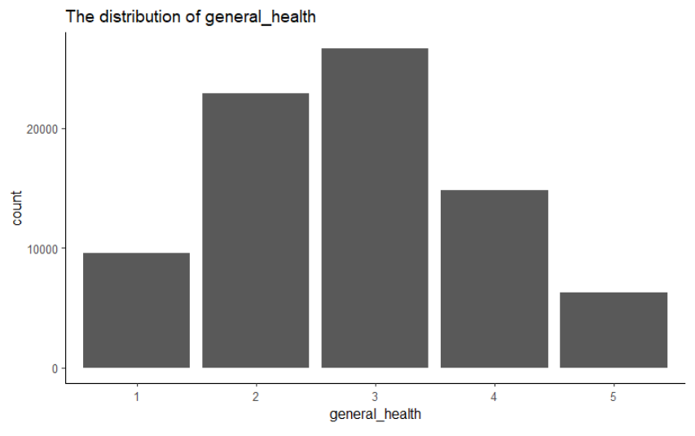
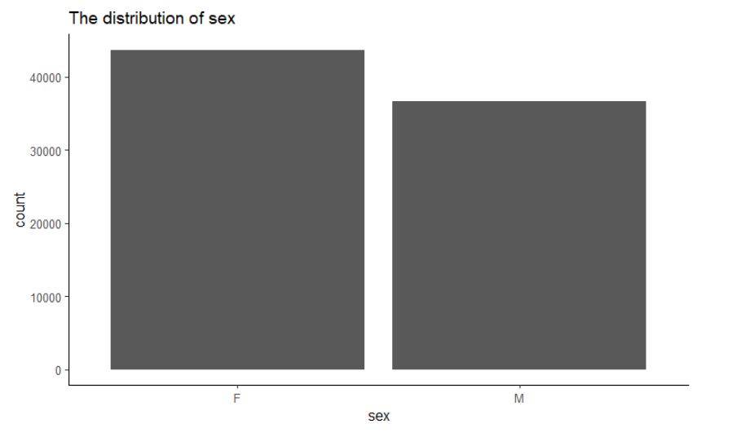
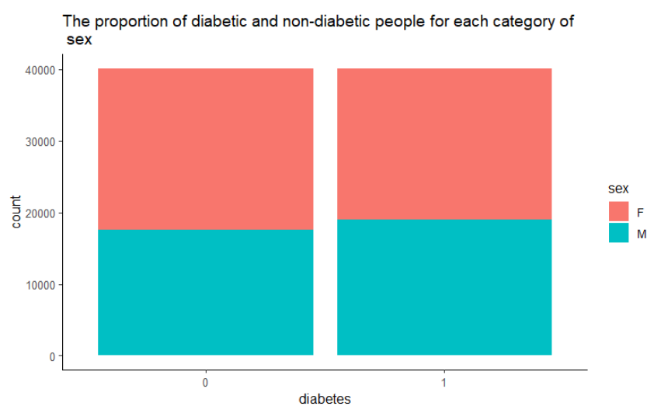
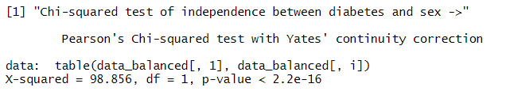
Exploratory Data Analysis Part 5: General Health and Gender
Notes:
This is strange because alcohol has a lot of sugar, which can equate to diabetes. However, it makes sense that there are a greater proportion of non-diabetic people who are heavy drinkers than diabetic people because when people have diabetes, they do not want to drink because it might kill them. As a result, this variable might not be the best variable to continue on with our analysis. Also, this might be caused by the fact that so few observations are heavy drinkers. A better variable might be "have you been a heavy or binge drinker in the past".

Slide 25
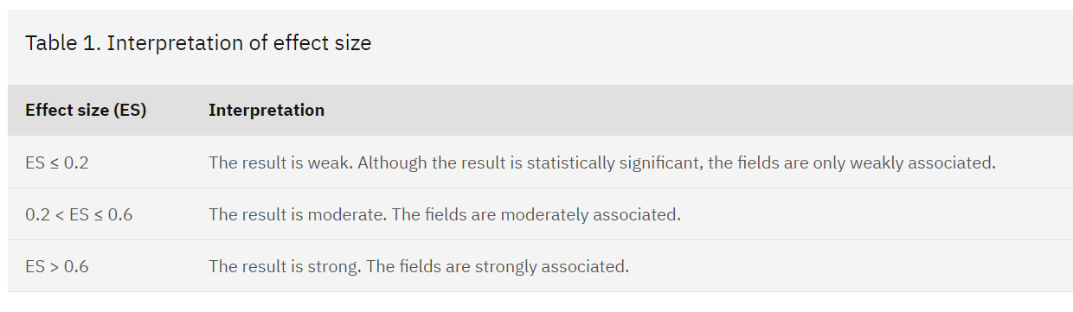
We will use Cramer’s V to measure the strength of the between factor variables
We will use this general guideline to measure strength between factor variables. Provided by IBM. Cramér's V - IBM Documentation

Slide 26
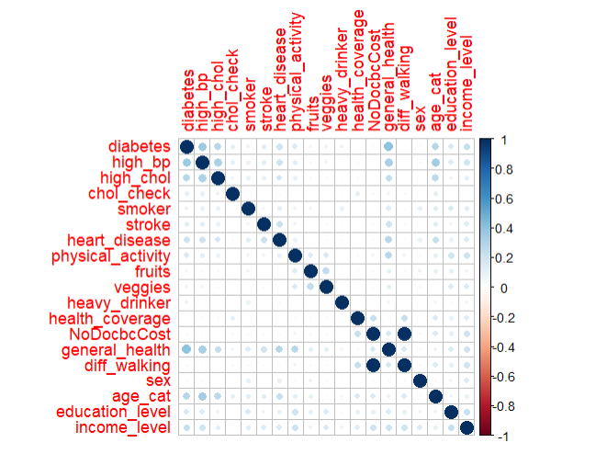
Relationships between the Factor Type Predictors and Diabetes. Also, Multicollinearity Among Factor Type Predictors:
Note: used Cramer’s V to measure how related the factor variables
Analysis - Relationship between Factor Type Predictors and Diabetes:
The factor type predictors that are most strongly related to diabetes with Cramer’s V > 0.2 are high_bp (0.36831274), high_chol (0.28622075), heart_disease (0.20287038), general health (0.40335672), age_cat(0.28755565), income_level(0.23323228)
Analysis - Multicollinearity Among Factor Type Predictors :
High_chol -> high_bp (0.31360472)
Heart_disease -> high_bp (0.20295323), Stroke (0.21907870)
Veggies -> Fruits (0.245024490)
NoDocbcCost -> health_coverage (0.229804631)
General_health -> high_bp (0.32292487), high_chol (0.24000009), stroke (0.20108227), heart_disease (0.28431391), physical_activity (0.27886606)
Diff_walking -> health_coverage (0.229804631), NoDocbcCost (1.000000000)
Conclusion:
Remove high_chol because high_chol closely related to high_bp, but high_bp has a stronger relationship with diabetes
Remove stroke because stroke is closely related to heart_disease and high_bp, but heart_disease and high_bp have a stronger relationship with diabetes
Remove fruits because fruits are closely related to veggies, but veggies have a stronger relationship with diabetes (0.077739849)
Remove health_coverage and NoDocbcCost because health_coverage and NoDocbcCost are closely related to Diff_walking, but Diff_walking is most closely related to diabetes
Remove general health because it is strongly related to many other variables. Although, general health is most closely related to diabetes, general health can simply be implied with other variables

Slide 27
Tentative Deadlines and Schedule:
Week 7: all variables selected, data cleaned, visualizations made, and logistic regression trained and analyze
Week 8 to 9: train and evaluate the rest of the machine learning models (naïve bayes, support vector machines, k-nearest neighbor, and decisions trees). Also, experiment with clustering and not clustering.
Week 10 to 11: create the application and get started on the final deliverables
Week 12 to 15: finish the final deliverables.

Slide 28
References
CDC. (2018). Behavioral Risk Factor Surveillance System [Data set]. kaggle. https://www.kaggle.com/datasets/alexteboul/diabetes-health-indicators-dataset?select=diabetes_binary_5050split_health_indicators_BRFSS2015.csv
CDC. (2022, June 29). National Diabetes Statistics Report. The Centers for Disease Control and Prevention. https://www.cdc.gov/diabetes/data/statistics-report/index.html
Islam, M.M., Ferdousi, R., Rahman, S., & Bushra, H. Y. (2019). Likelihood Prediction of Diabetes at Early Stage Using Data Mining Techniques. In Computer Vision and Machine Intelligence in Medical Image Analysis (pp. 113–125). Springer Singapore. https://doi.org/10.1007/978-981-13-8798-2_12
Knowler, W., Barrett-Connor, E., Fowler, S. E., Hamman, R. F., Lachin, J. M., Walker, E. A., & Nathan, D. M. (2002). Reduction in the Incidence of Type 2 Diabetes with Lifestyle Intervention or Metformin. The New England Journal of Medicine, 346(6), 393–403. https://doi.org/10.1056/NEJMoa012512
Petersen, M. (2018). Economic Costs of Diabetes in the U.S. in 2017. Diabetes Care, 41(5), 917–928. https://doi.org/10.2337/dci18-0007
Teboul, Alex (2019). Diabetes Health Indicators Dataset [Data set]. kaggle. https://www.kaggle.com/datasets/alexteboul/diabetes-health-indicators-dataset?select=diabetes_binary_5050split_health_indicators_BRFSS2015.csv
Xie, Z., Nikolayeva, O., Luo, J., & Li, D. (2019). Building Risk Prediction Models for Type 2 Diabetes Using Machine Learning Techniques. Preventing Chronic Disease, 16. https://doi.org/10.5888/pcd16.190109

